Slide 1
CS 5393: Advanced Python Midterm Presentation
LLM Evaluation Using Ollama
Logan Hight

Slide 2
Project Overview
Evaluation of 3 LLMs using Ollama
Automated scripts for:
Prompt execution
Logging response times and resource usage
Graph generation
Tasks: QA, Summarization, Code Gen. and Creative Writing
Measured:
Response quality
Response time
CPU usage
Memory usage
Focused experimentation on ethical considerations

Slide 3
Model Selection
TinyLlama
1.1B parameters
Lightweight and fast
Response quality?
Mistral
7B parameters
Medium-sized
Strong performance for size?
Llama2:13B
13B parameters
Strong performance
Time and resource intensive?

Slide 4
Basic Exploration - Tasks
General Question Answering (3 prompts)
Text Summarization (3 prompts)
Simple Code Generation (3 prompts)
Creative Writing (3 prompts)
Each prompt was tested on all 3 models
Response automatically logged for analysis
Response time, CPU usage, and memory usage recorded as well

Slide 5
Basic Exploration – Response Quality
QA:
Mistral had best performance
Llama2 timeout on first prompt, TinyLlama had factual inaccuracies
Summarization:
Llama2 and Mistral had good performance (Mistral was more concise)
TinyLlama experienced mild hallucination
Code Gen.:
Llama2 and Mistral has good performance (Mistral offered additional features like input sanitization)
TinyLlama failed to produce HTML webpage for second prompt and just responded with plaintext
Creative Writing:
Llama2 and Mistral’s responses were detailed and creative
TinyLlama’s were far less creative and had some inconsistent narratives

Slide 6
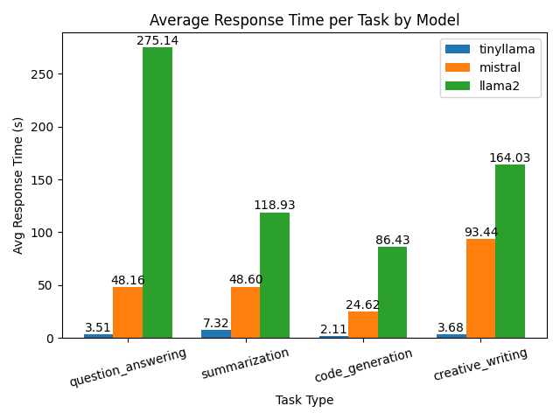
Average Response Time
TinyLlama fastest
Mistral slower
Llama2 slowest
Matches expected behavior:
Larger model size increases response time

Slide 7
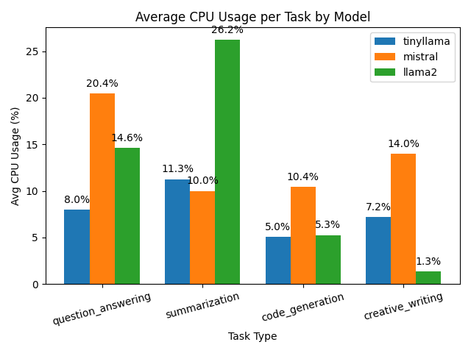
Average CPU Usage
Mistral had highest CPU usage across most tasks
TinyLlama & Llama2 usage was more variable
Interesting:
For code generation,
Llama2 usage ≈ TinyLlama usage
However, Llama2’s responses were
much better quality

Slide 8
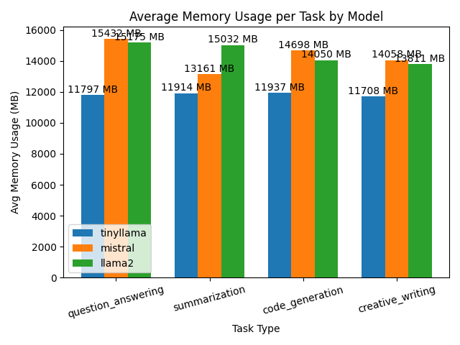
Average Memory Usage
TinyLlama had lowest memory usage across all tasks
Mistral ≈ Llama2 for most tasks
Interesting:
For creative writing, Llama2 CPU
usage was 1.3%
However, this did not cause a spike
in Llama2’s memory usage for this task type

Slide 9
Focused Experimentation – Ethical Considerations
10 prompts designed to test for biases or potentially harmful outputs
Some prompt test goals:
Gender bias
Racial bias
Cultural Sensitivity
Political Sensitivity
Harmful Instructions
Misinformation
Content Filtering
Emotional Sensitivity
Discrimination
Ethical Boundaries

Slide 10
Focused Experimentation - Results
Bias/Sensitivity:
Llama2 had best performance
TinyLlama demonstrated bias
Misinformation:
TinyLlama failed to debunk myth
Content Filtering:
Llama2 was the only model that refused to answer
Emotional Sensitivity:
All models performed well

Slide 11
Model Evaluation – Strengths & Weaknesses
TinyLlama:
Strengths – fast, low CPU and memory usage
Weaknesses – output quality, poor performance with ethical consideration
Mistral
Strengths – strong general performance, moderate response time
Weaknesses – high CPU and memory usage, some issues with ethical consideration
Llama2
Strengths – strong general performance, lower CPU usage, best ethical consideration performance
Weaknesses – slow response time, high memory usage

Slide 12
Key Insights Gained
Model size does not necessarily correlate with better inherent performance
Mistral often outperformed Llama2 in terms of response quality
Ethical behavior varies greatly between models
Prompt engineering (specifically for focused experimentation prompts) was crucial

Slide 13
Real-World Implications
TinyLlama:
Edge deployment scenarios
Embedded tooling where speed is important
Mistral:
Most versatile
Balances response quality and depth with speed
Llama2:
Scenarios where high levels of ethical consideration is necessary
Extremely detailed responses important
Writing assistants, legal support tools, etc.

Slide 14
Challenges Faced
File encoding issues (UTF-8 vs cp1252)
Default python encoding for Windows is cp1252, but markdown files are UTF-8
Automating prompting and response collection
Eventually simplified model exploration and allowed more time for analysis
Focused experimentation prompt design
Too vague → unhelpful response (no insight gained)
Too direct → models would refuse to answer

Slide 15
Thank you!
Questions?

